Slide 1

Big-O Notation and Time Complexity

Slide 2
Topics
We will cover these points
What's the Big(-O) deal?
Big-Order of magnitude
Basic Examples

Slide 3
What's the Big(-O) deal?
Efficiency of an algorithm covers lots of resources, including:
CPU (time) usage
Memory usage
Disk usage
Network usage
All of the above are very important. But we all focus on the “Time complexity (CPU usage)”
Performance - how much time/memory/disk/etc. is used when a program is run. This depends on the machine, compiler, etc. as well as the code.
Complexity - how do the resource requirements of a program or algorithm scale. In other words: what happens as the size of the problem being solved gets larger?.
Complexity affects performance but not the other way around.
Big-O notation tells you the complexity of an algorithm in terms of the size of its input, it is essential to understand Big-O if you want to know how algorithms will scale.
What is Big-O?
Big order of magnitude
Examples
Conclusion

Slide 4
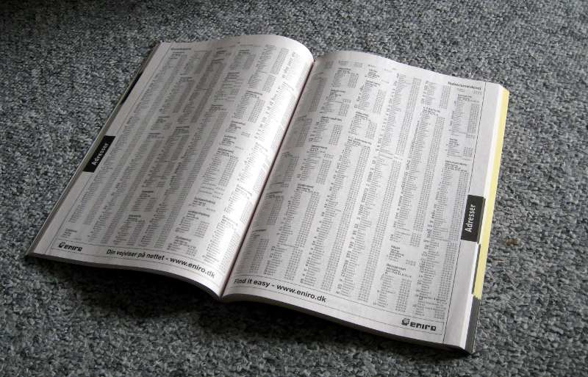
What's the Big(-O) deal? Contd.
Let’s take an example – A Telephone Directory
You need to find out a particular person's information. What would be the approach you would take
Approach 1 – Linear approach. Searching for the person one by one.
Best case – Person details are on 1st page
Worst case – Details are on last page.
Approach 2 – Binary search. Searching for the person by dividing the book into parts and than further dividing till you get the details.
Best case – Person details are on 1st page
Worst case – Details are on last page.
What is Big-O?
Big-Order of Magnitude
Examples
Conclusion

Slide 5
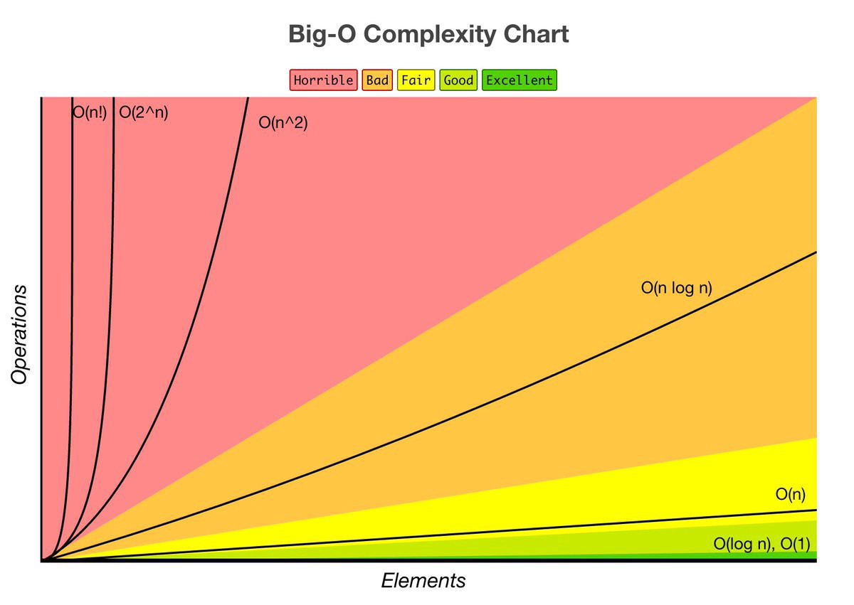
Big-Order of magnitude
Constant – O(1)
Logarithmic – O(log n)
Linear – O(n)
Log Linear – O(n log n)
Quadratic – O(n²)
Exponential – O(2^{n})
Factorial – O(n!)
Big-Order of Magnitude
What is Big-O?
Examples
Conclusion

Slide 6
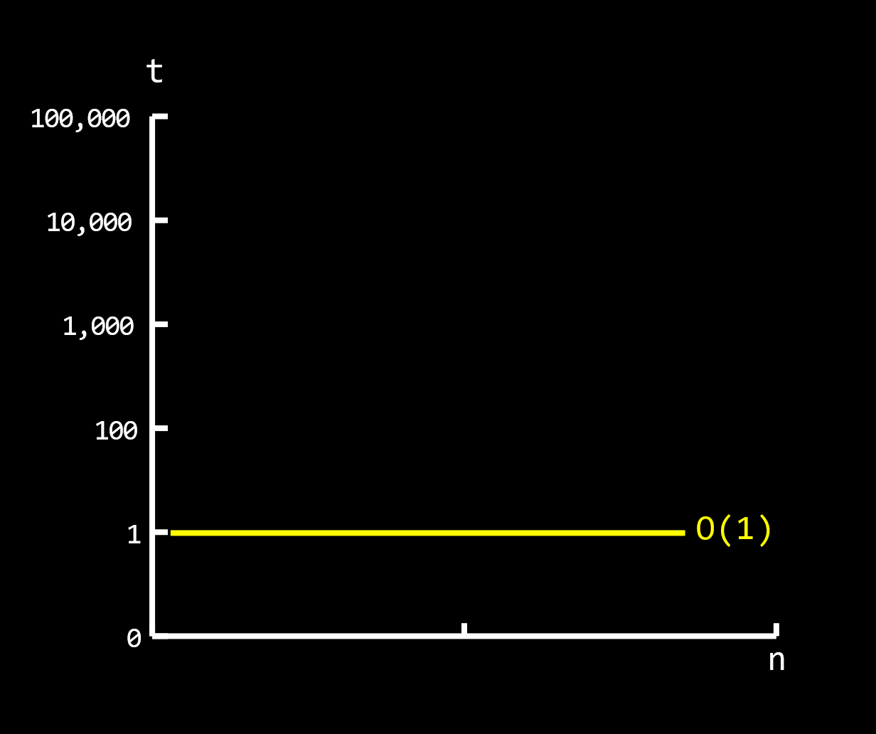
Constant Time or O(1)
O(1) describes an algorithm that will always execute in the same time (or space) regardless of the size of the input data set.
int sumTwoNumbers(int a, int b)
{
return a + b;
}
int example = 1;
As you can see in the graph constant time is indifferent of input size. Declaring a variable, inserting an element in a stack, inserting an element into an unsorted linked list all these statements take constant time.
Example: Retrieving a value from a hash table(dictionary) with a key
Examples
What is Big-O?
Big-Order of Magnitude
Conclusion

Slide 7
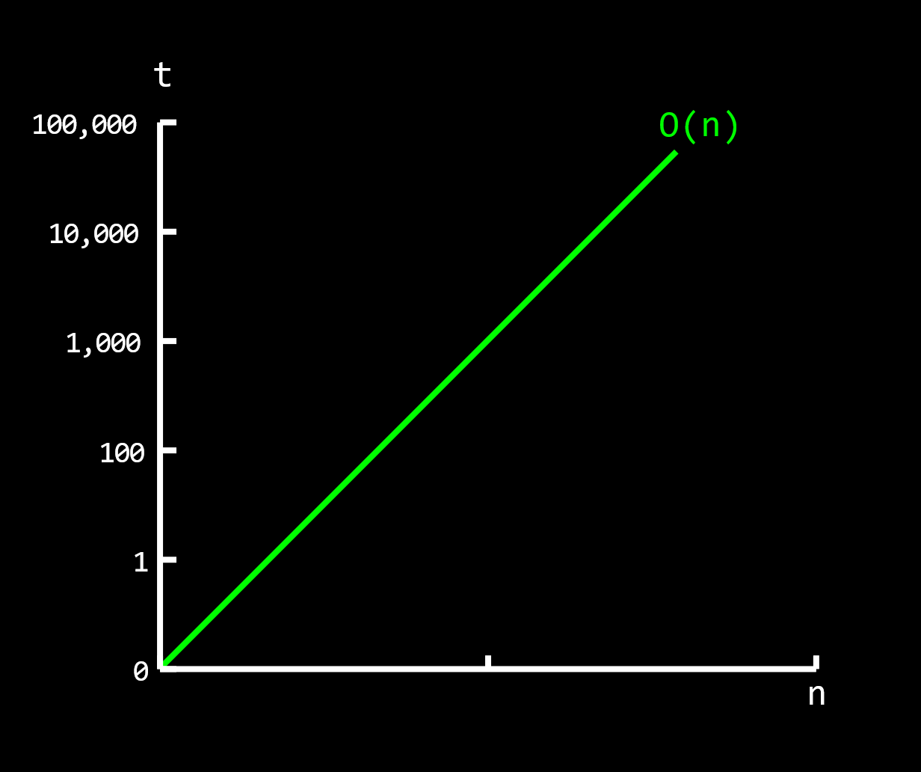
Linear Time or O(n)
O(n) describes an algorithm whose performance will grow linearly and in direct proportion to the size of the input data set.
for (int i = 0; i < N; i++)
{
// do any operation like print number
}
In the following graph we can see how running time increases linearly in relation to the number of elements n.
More examples of linear time are:
Finding an item in an unsorted collection
Examples
What is Big-O?
Big-Order of Magnitude
Conclusion

Slide 8
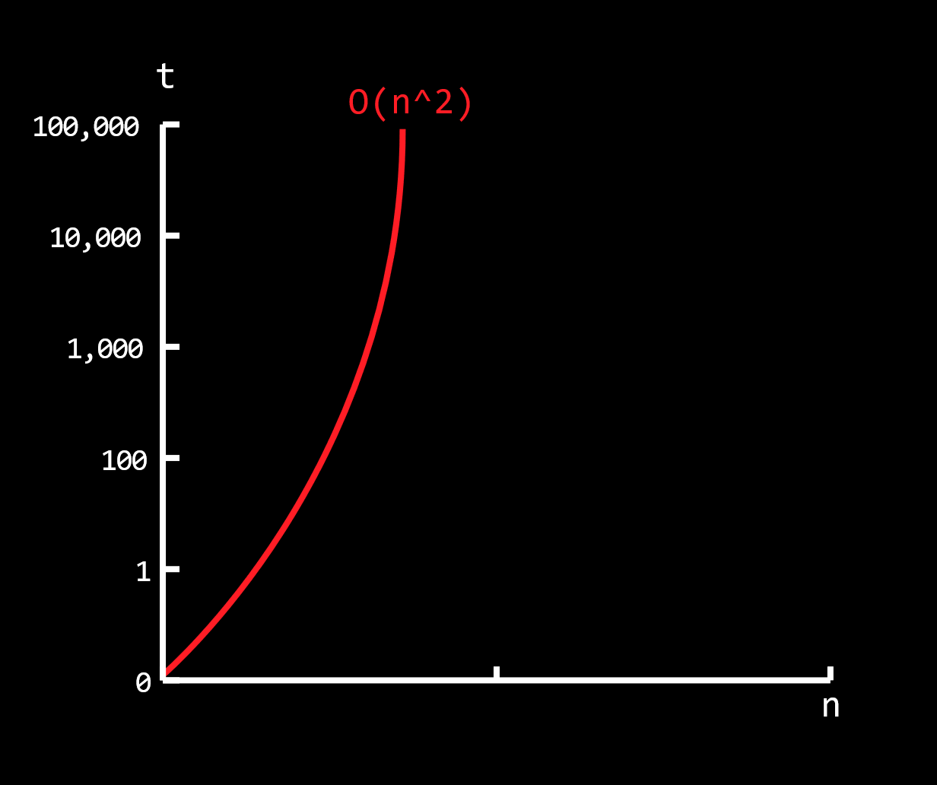
Quadratic Time or O(n²)
O(n²) describes an algorithm whose performance will grow linearly and in direct proportion to the size of the input data set squared.
for (int i = 0; i < N; i++)
{
for (int j = 0; j < N; j++)
{
// do any operation like print number
}
}
Algorithms that scale in quadratic time are better to be avoided. Once the input size reaches n=100,000 element it can take 10 seconds to complete
More examples of quadratic time are:
Performing search in a matrix
Examples
What is Big-O?
Big-Order of Magnitude
Conclusion

Slide 9
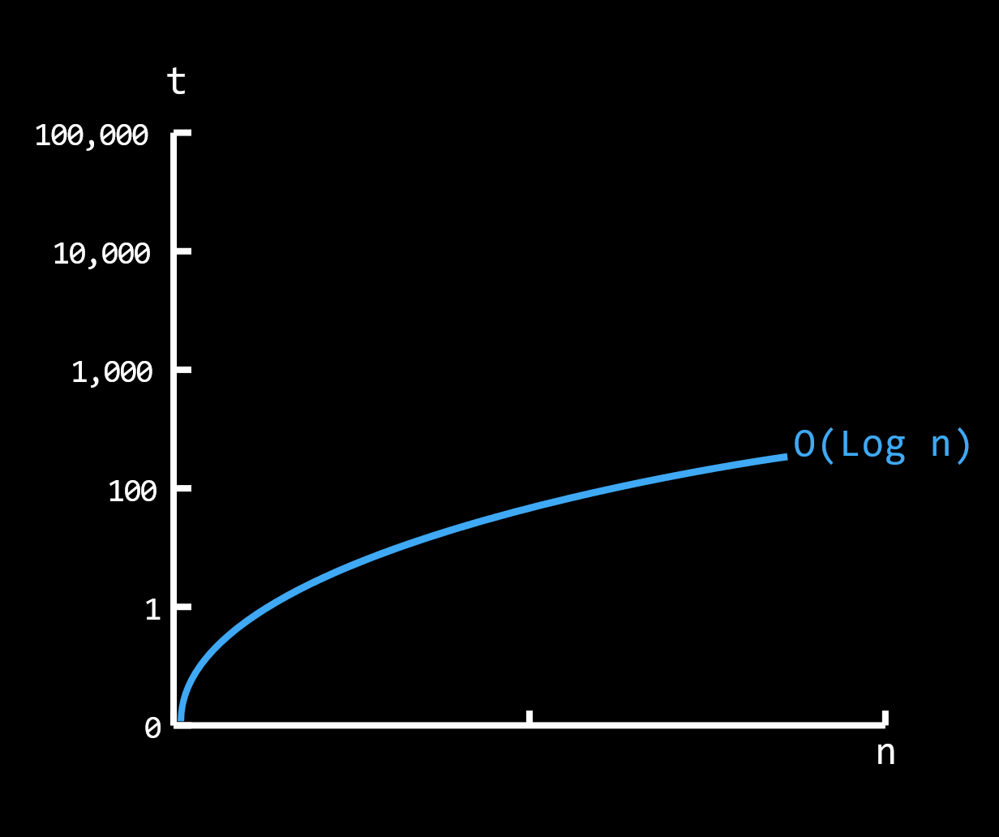
Logarithmic Time or O(log n)
Algorithms with an order of log n generally reduce the problem size with each operation. The most common attributes of these algorithms are that:
the choice of the next element on which to perform some action, is one of several possibilities, and
only one of these possibilities will need to be chosen.
for (int i = 0; i < N; i *= 2)
{
// do any operation like print number
}
Logarithmic time grows slower as N grows.
Example of logarithmic time are:
Binary search
Examples
What is Big-O?
Big-Order of Magnitude
Conclusion

Slide 10
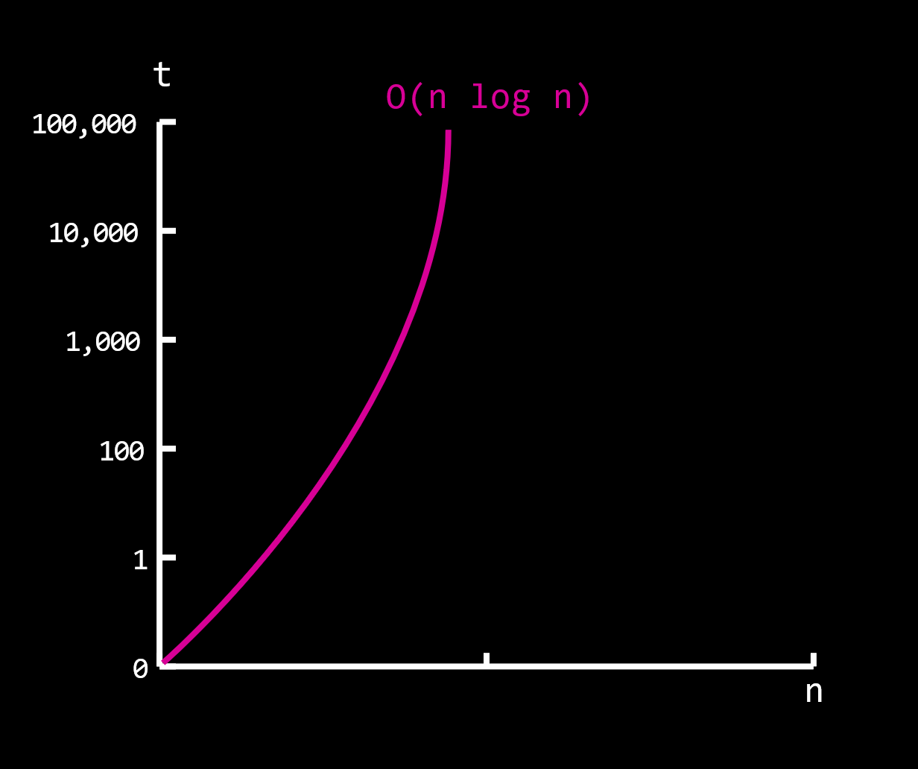
Log linear or O(n log n)
Algorithms with an order of O(n log n) performs a O(logn) operation for each item in the input.
for (int i = 0; i < N; i ++) // linear loop O(n)
{
for(int j = 1; j < N; J *= 2) { // log(n)
// do any operation like print number
}
}
The algorithms with O(n log n) are capable of good performance with very large data sets.
Some examples of linearithmic algorithms are:
Merge sort
Quick sort
Examples
What is Big-O?
Big-Order of Magnitude
Conclusion

Slide 11
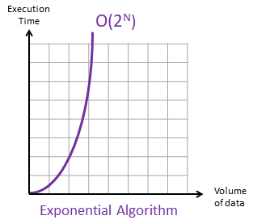
Exponential or O(2^{n})
O(2^{n}) complexity is an algorithm whose growth doubles with each addition to the input data set.
With small data sets the growth curve is small but it rises exponentially when the input gets larger.
Consider below factorial example
Fibonacci(int number) {
if(number <= 1) {
return number;
}
return Fibonacci(number - 1) + Fibonacci(number - 2)
}
Examples
What is Big-O?
Big-Order of Magnitude
Conclusion

Slide 12
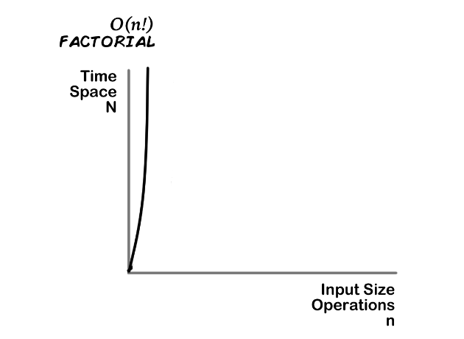
Factorial or O(n!)
O(n!) represents an algorithm which has to perform n! computations to solve a problem.
This algorithm takes a massive performance hit for each additional input element. For example, an algorithm takes 2 sec to compue 2 elements, will take 6 seconds to calculate 3 and 24 seconds to calculate 4
Example of O(n!) complexity
Traveling Salesman Problem
void nFacRuntimeFunc(int number) {
for (int I = 0; I < number; I++) {
nFacRuntimeFunc(number - 1);
}
}
Examples
What is Big-O?
Big-Order of Magnitude
Conclusion

Slide 13
Summary
Here is what we learned
Algorithm speed is not measured in seconds but in terms of growth
The Big-O Notation tells us how an algorithm scales against changes in the input dataset size
Algorithm running times grow at different rates:
O(1) < O(logN) < O(N) < O(N logN) < O(N²) < O(2ᴺ) < O(N!)
Conclusion
First Skill
Second Skill
Third Skill

